Slide 1
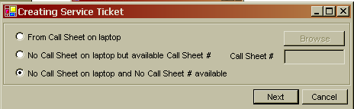
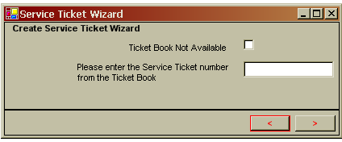
If the Ticket Book Not Available is checked, gray out the e Service ticket Number text box
Service Tickets number generated by the system will start at 11,000,000

Slide 2
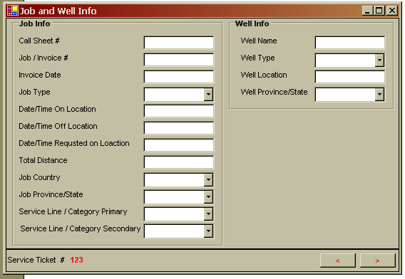
A number that generated by the system
Job# = Service Ticket#
Here we need to add:
Number of MTS related to this service Ticket = textbox
Number of Service Reports related to this Service Ticket = textbox

Slide 3
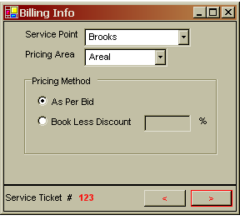
For pumping only: we have one service point and one pricing area, for other service lines, we might have more than one for each

Slide 4
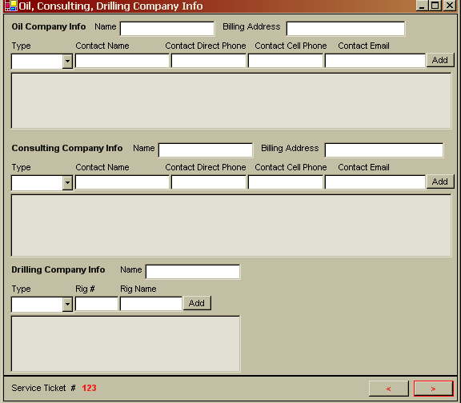

Slide 5
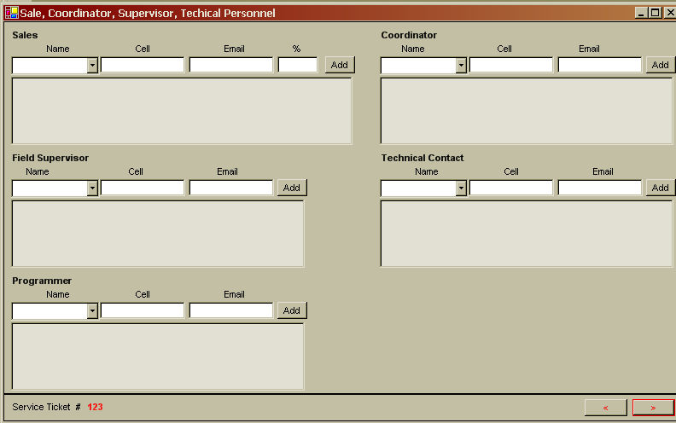
One a job that has multiple Service Lines, the Field Supervisor is charge will be Called: Single Point of Contact (SPOC, we need to note this here.

Slide 6
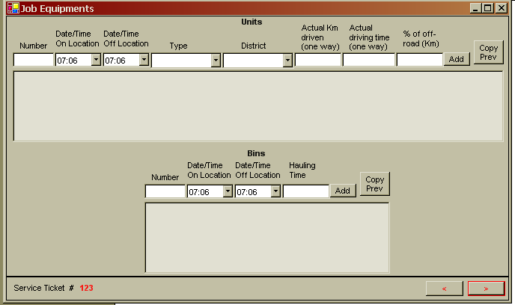

Slide 7
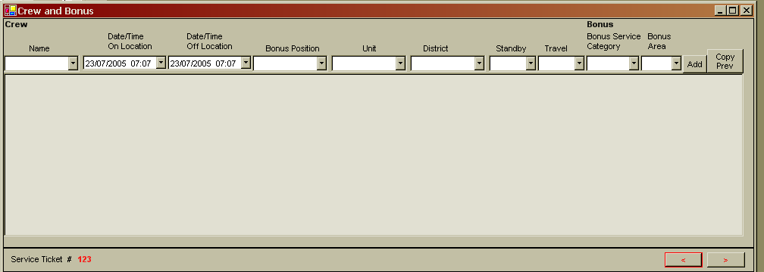

Slide 8
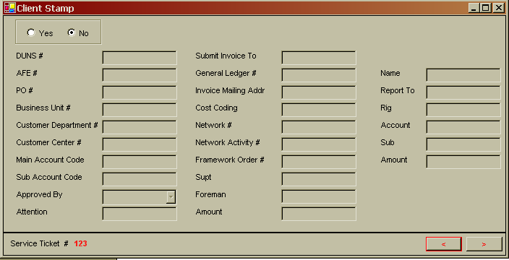

Slide 9
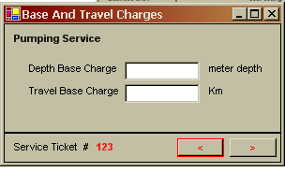
For pumping only: we have one depth and one travel, for other service lines, we might have more than one for each

Slide 10
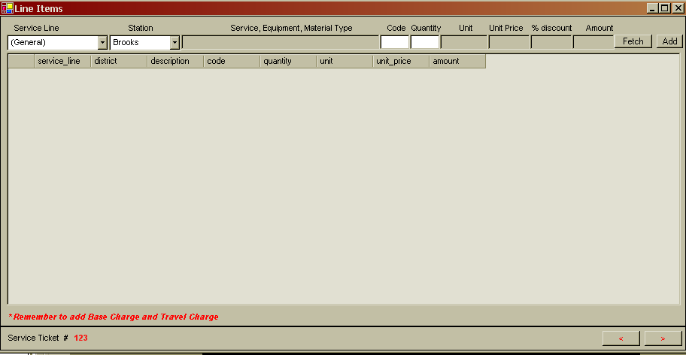
Per line item:
  The % Discount should = the Book Less Discount % OR the zero if it is As Per Bid
  If the Item is not discountable, the % Discount column should be grayed out
Also items populated in this grid need to be grouped by category, like setup. . . ..
Also make sure there is line item(s) that reflect the depth base charge and the travel base charge

Slide 11
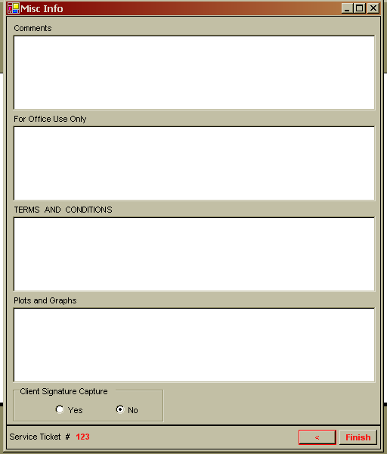
Spell check on all comment boxes

Slide 12
